Slide 1
Microprocessor System Design
Omid Fatemi
8088 Microprocessor
(omid@fatemi.net)

Slide 2
Outline
Pin configuration
Minimal / Maximal mode
Address latch enable
Bi-directional data bus

Slide 3
The Microprocessor
An integrated circuit with millions of transistors interconnected with very small aluminum wires.
Controls and directs activities of the computer.
Execute stored programs.

Slide 4
Von Neumann Architecture
Microprocessor
Memory
Address Lines
Actual
Processor
Program
Data Lines
Registers
Data
Control Lines

Slide 5
The 8086 Family:the Late 1970’s
Could address up to 1 mb of memory at a time when other CPU’s could only address 64 kb.
The 16 bit external bus too powerful.
The 8088 replaced the 8086 and had only an 8 bit external bus.
The 8088 CPU was the first chip used in IBM’s microcomputers.
8088
Data is organized into byte widths
The 1MB memory is organized as 1M x 8-bits
8086/80186
Data is organized into word widths
The 1MB memory is organized as 512k x 16-bits

Slide 6
The 80286 Family:1983
Wanted to make the 286 backward compatible with the 8088’s.
So had 2 modes:
Real mode-less powerful.
Protected mode-very powerful.
Could access up to 16 mb of memory.
Needed a special operating system.
But most users only had DOS.
80286/80386SX
Data is organized into word widths
The 16MB memory is organized as 8M x 16-bits

Slide 7
The 386 DX: 1985
First true 32 bit chip, all buses 32 bits wide
Capable of running in real mode, 286 protected mode and its own 386 protected mode
In 386 protected mode it had 2 new functions:
Virtual memory- could use hard drive to pretend that computer had up to 4 GB of data!
Virtual 8086- 8086 bubbles created for DOS
• 80386DX/80486
Data is organized into double word widths
The 4GB memory is organized as 1G x 32-bits

Slide 8
The 386 SX:1988
How different from the 386DX?
External data bus reduced to 16 bits
Address bus reduced to 24 bits, which limited memory use to 16 mb
First popular laptops were based on the 386SX but was called the 386 SL and ran on 3.3 volts

Slide 9
The 486DX:1989
How different from the 386 family?
A built in math coprocessor.
Performs high math functions.
A built in 8K cache on same chip.
This was an SRAM cache that stores code read in the past. When the CPU asks for the code again, it doesn’t have to go to DRAM to get it.

Slide 10
486SX:1991
Same as 486 DX except the math co-processor is disabled.

Slide 11
The Pentiums:1993
Had 64 bit external data bus that split internally as 2 dual pipelined 32 bit buses
Supported an 8K write through cache for programs
Most early Pentiums ran at 3.3 volts. This conserved heat. Voltage regulators on the motherboard can decrease voltage
Includes clock doubling through the setting of jumpers

Slide 12
Recent Pentiums:after 1996
MMX- helps with multimedia products
Increased multipliers/clocks
Improved processing- better cache branch predicting
Improved superscalar architecture
SSE/SSE2 instructions
• Pentium Pro/Pentium 1-4
Data is organized into quad word widths
The 4GB memory is organized as 512MB x64-bits
(on P2-4, actual address bus is 36 bits)

Slide 13
8088 Microprocessor
Minimum Mode

Slide 14
Pin Configuration

Slide 15
Power and Ground Pins
Vcc – pin 40
Gnd – pin 1 and 20

Slide 16
Address Pins
AD0..AD7
A8..A15
A19/S6, A18/S5, A17/S4, A16/S3

Slide 17
Data Pins
AD0..AD7

Slide 18
Control Pins
MN/MX’ (input)
Indicates what mode the processor is to operate in
READY (input)
When given an input LOW, it will go into a wait state
CLK (input)
Provides basic timing for the processor
RESET (input)
Causes the processor to immediately terminate its present activity
To reset the microprocessor, this must be HIGH for at least 4 clock cycles

Slide 19
Control Pins
TEST’ (input)
Connect this to HIGH
HOLD (input)
Connect this to LOW
HLDA (output)

Slide 20
Control Pins
INTR (input)
Interrupt request
INTA’ (output)
Interrupt Acknowledge
NMI (input)
Non-maskable interrupt

Slide 21
Control Pins
DEN’ (output)
Data Enable
It is LOW when processor wants to receive data or processor is giving out data
DT/R’ (output)
Data Transmit/Receive
When HIGH, direction of data lines is from microprocessor to memory/devices
When LOW, direction of data lines is from memory/devices to microprocessor
IO/M’ (output)
Device/Memory
When HIGH, microprocessor wants to access I/O Device
When LOW, microprocessor wants to access memory

Slide 22
Control Pins
RD’ (output)
When LOW, it indicates that the microprocessor is performing a read access
WR (output)
When LOW, it indicates that the microprocessor is performing a write access
ALE (output)
Address Latch Enable
Provided by the microprocessor to latch address
When this is HIGH, microprocessor is using AD0..AD7, A19/S6, A18/S5, A17/S4, A16/S3 as address lines

Slide 23
Clock Signal
needed by the microprocessor to synchronize signals
ideally a square wave having a constant frequency

Slide 24
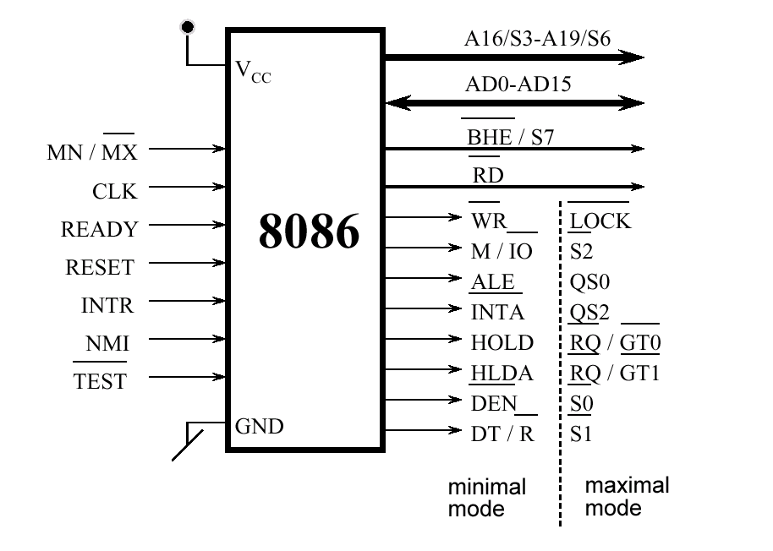
8086 Signals

Slide 25
Providing Clock, Reset, and Ready Signal
8284A

Slide 26
Minimum Mode

